Slide 1






Slide 2



A typical digital computer has many registers, and paths must be provided to transfer information from one to another register for performing various operations in the computer system. The number of wires will be excessive if separate lines are used between each register to all other register. A more efficient and widely used method for transferring data between multiple register is common bus line system.

Slide 3


A bus structure consist a set of common lines each for each register, through which binary information can transfer one at time. Control signal determine that which register is connected with a bus line at time to transfer the information.
Here we will see two ways to construct the bus : By using multiplexers.
By three state buffer.

Slide 4

One way of constructing bus system is by using
multiplexers. The multiplexer select the one register who ‘s information is transfer to another one destination register.
In a bus system, multiplex K register of n bits each to produce an n lines common bus .The number of multiplexers needed to construct the bus is equal to n.Size of each mux is must be k-1multiplexer hence multiplexer have n data lines.

Slide 5



Example: For common bus system using multiplexer for 16 register each of 32 bit data transformation.
solution: In this system we require 32(number of bits) multiplexer each having size of 16-1 multiplexer(number of register) and number of selection inputs are 4 .

Slide 6




Slide 7
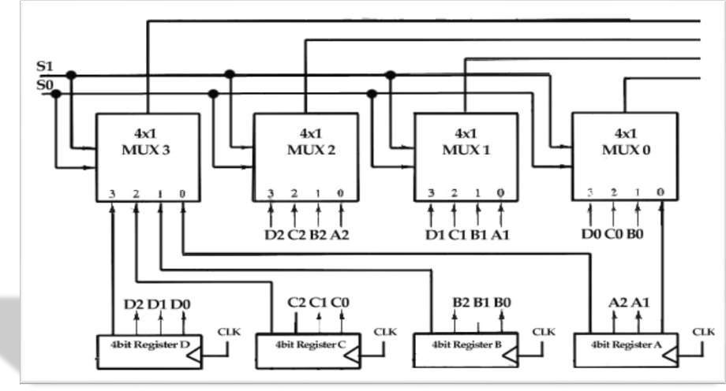
 The construction of bus system for four bit, four register is given below:

Slide 8

As we know that for n bit we require n multiplexer, for k register transfer we require k-1 size of multiplexer.
Here we have n=4 and k=4 hence here we use four multiplexer each having 4-1 size.
Here each register have 4 positive triggered flip-
flop set. because each mux is 4-1 each multiplexer have 2 selection inputs in the bus.

Slide 9


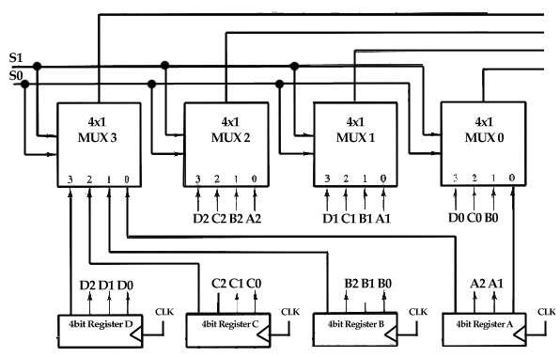
we denote it by S0 and S1. This selection input select the one line output from 0 to 3 available in the each multiplexer, and applied to the output that form a bus system.
To avoid the complicated figure we just write output and input at the connection. For example output A1 of register A is connected with the input line 0 of mux(1) because that input is labeled as A1.

Slide 10









Slide 11

The two selection lines S and S are connected to the selection inputs of all four multiplexers.
The selection lines choose the four bits of one register and transfer them into the four-line common bus.
When S1S0 =00, the 0 data inputs of all four multiplexers are selected and applied to the outputs that form the bus.
This causes the bus lines to receive the content of register A since the outputs of this register are connected to the 0 data inputs of the multiplexers.
Similarly, register B is selected if S1S0= 0 1, and so on.

Slide 12
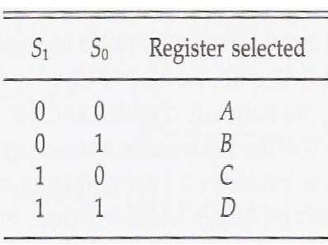
Table 1 shows the register that is selected by the bus for each of the four possible binary value of the selection lines.
TABLE 1 Function Table for Bus of Fig. 1

Slide 13









Slide 14


The transfer of information from a bus into one of many destination registers can be accomplished by connecting the bus lines to the inputs of all destination registers and activating the load control of the particular destination register selected.
The symbolic statement for a bus transfer may mention the bus or its presence may be implied in the statement.
When the bus is includes in the statement, the register transfer is symbolized as follows.

Slide 15


The content of register C is placed on the bus, and the content of the bus is loaded into register R1 by activating its load control input.
If the bus is known to exist in the system, it may be convenient just to show the direct transfer.
From this statement the designer knows which control signals must be activated to produce the transfer through the bus.

Slide 16



Slide 17

Memory Transfer The transfer of information from a memory word to the outside environment is called a read operation.
The transfer of new information to be stored into the memory is called a write operation.
A memory word will be symbolized by the letter M. The particular memory word among the many available is selected by the memory address during
the transfer.
It is necessary to specify the address of M when writing memory transfer operations.
This will be done by enclosing the address in square brackets following the letter M.

Slide 18




The address register, symbolized by AR.
The data are transferred to another register, called the data register, symbolized by DR.
The read operation can be stated as follows:

Slide 19




memory write this causes a transfer of information into DR from the memory word M selected by the address in AR.
The write operation transfers the content of a data register to a memory word M selected by the address.
Assume that the input data are in register R1 and the address is in AR.
The write operation can be stated symbolically as follows

Slide 20



